Slide 1
Maths Information evening

Slide 2
Question
Investigation
Confidence/ strategy
Problem solving
Real life
- contextual
abstract
4 operations
(fluent in the fundamentals of maths)
Analysis
interpret
Place value – principle of exchange
Rapid recall of number facts
Vocabulary
Relationships and patterns / reasoning
Notes:
So, to begin with, there are different illustrations and models which try to show how different aspects of maths are inter-connected and dependent on each other. In this example you can see..
Foundations of maths are:
Place value
Rapid recall of number facts
Rich vocab
Relationships and patterns of numbers, shapes, etc.
Only when they are embedded, can you build upon them to do problem solving, the 4 operations of + - x div and analysis and interpreting number.
When these ‘columns’ are embedded, then we are able to question what we know, investigate and have the confidence and strategies to tackle non-routine maths / maths we have not seen before.

Slide 3
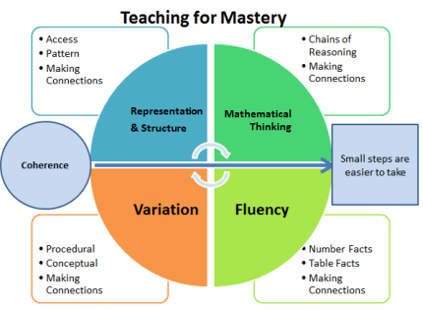
Notes:
A model we follow for teaching maths is the “Teaching for Mastery” model where we build in these elements into our teaching.
So, for example:
Aspects of a lesson that develop fluency skills – recall for example.
Providing different contexts or varying the examples of how to use mathematical concepts – 25-23 could be subtraction written method or adding on finding the difference – more than one way of solving it.
Providing different representations – bar model/use of apparatus/part-part whole/ number line
Encouraging thinking about their understanding through problem solving or explaining reasons for calculations. – true or false/ odd one out.
Tonight, we are going to focus on the fluency aspect of this – This has been a main focus for us this year in school and we think it forms the foundation for the other aspects of maths to be developed through – as in the previous slide.

Slide 4
FLUENCY

Slide 5
“The national curriculum for mathematics aims to ensure that all pupils become fluent in the fundamentals of mathematics…
Notes:
So the national curriculum states…

Slide 6
… through varied and frequent practice with increasingly complex problems over time, so that pupils have conceptual understanding and are able to recall and apply their knowledge rapidly and accurately to problems.”
Notes:
What this means is..(and can be taken form the mastery model).
Varied – formal and informal approaches (games/ repetition)
Frequent – daily/ little and often is more effective
Increasingly complex problems – as children progress through year groups/ curriculum/ levels etc what they are challenged to do will become ‘increasingly more complex eg
Recall - is ‘rapid’ - less than 5 seconds and does not include counting on fingers/ or counting out loud to compute
Apply – to solve a wider range of problems with a varying degree of steps (add, multiply, subtract all within the same problem)

Slide 7
So, what does a fluent mathematician look like?

Slide 8
Mathematical fluency requires:
Mathematical Accuracy
Mathematical Efficiency
Mathematical Flexibility
Notes:
And what we mean by this is…

Slide 9
Accuracy: (factual knowledge) depends on several aspects of the problem-solving process, among them careful recording, knowledge of number facts and other important number relationships, and double-checking results.
Efficiency: (procedural fluency) implies that the student does not get bogged down in too many steps or lose track of the logic of the strategy. An efficient strategy is one that the student can carry out easily, keeping track of sub problems and making use of intermediate results to solve the problem.
Flexibility: (conceptual fluency) requires, the knowledge of more than one approach to solving a particular kind of problem, such as a two-digit multiplication. Students need to be flexible in order to choose an appropriate strategy for the problem at hand, and also to use one method to solve a problem and another method to double-check the result.
Fluency demands more of students than does memorisation of a single fact or procedure.
Notes:
Accuracy: lets focus on the recall of knowledge here – being able to recall tables facts, number bonds but also facts such as 1000ml in 1l, 180 degrees in a triangle, knowing a square has 4 equal sides – and being able to quickly draw in this knowledge accurately.
Efficiency:
Procedural fluency – knowing how to approach calculations or a problem. Being fluent enough in the process to be accurate – for example being able to carry out written methods – long division, multiplication and record this in steps.
Flexibility:
Building on the efficiency – knowing and being flexible enough to choose the most efficient method/strategy to solve a calculation or problem – 100-99=1
25% of a number - 10%+10%+5% or just a quarter so divide by 4
These are all about reducing the cognitive load when solving maths problems – the more fluent you are the easier the problem as there will be less to actually calculate and therefore the margin for error is reduced.

Slide 10
Maths in the Early Years Foundation Stage

Slide 11
The only way to learn maths is to do maths.

Slide 12
Early Learning Goal for Number
* Have a deeper understanding of a number to 10, including the composition of each number.
* Subitise (recognise quantities without counting) up to 5.
* Automatically recall (without reference to rhymes, counting or other aids) number bonds up to 5 (including subtraction facts) and some number bonds to 10, including double facts.

Slide 13
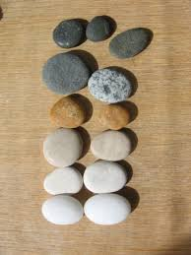
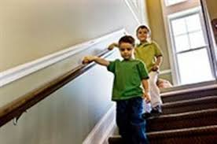
How to count
Count forwards and backwards up the stairs. Start at different numbers and count on and count back.
Count everyday objects, every day. Counting to begin with is like learning a nursery rhyme.

Slide 14
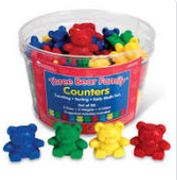
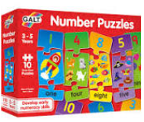

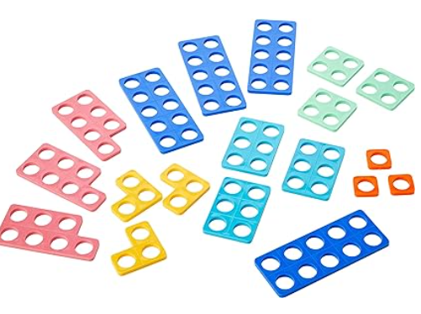
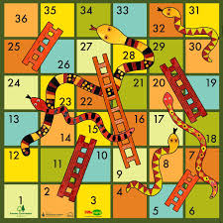
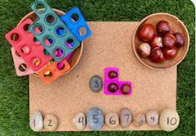
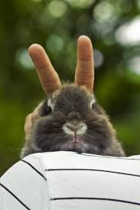
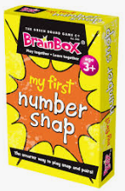
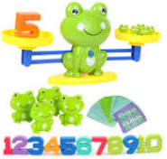
Play Games
Notes:
What is a number?
What does 2 look like?
Is it a bigger number than 4?
How do you know?

Slide 15
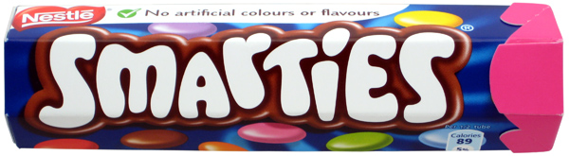
A way you can incorporate number at home
Using maths talk every day will help children to understand concepts and apply their knowledge to problem solving.

Slide 16

How many different maths words can you use to describe the contents of your smarties box?

Slide 17
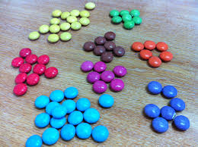
Which words did you use?
more
less
difference
same
total
altogether
share
equals
groups
larger
smaller
counting

Slide 18
Maths in Year 1

Slide 19
We focus on
Developing a mastery understanding including …
Counting > forwards and backwards
Skip counting in 2s, 5s and 10s
Number bonds
Addition
Subtraction
Solving word problems
Missing number sentences

Slide 20
Maths in Year 2

Slide 21
We focus on
Developing a mastery understanding including …
Counting > forwards and backwards within 100
Number bonds to 10 and 20
Addition and Subtraction (column method)
Missing number sentences
Times tables involving 2s, 5s and 10s and challenge the children to include their 3s
Doubles and halving
Solving word problems

Slide 22
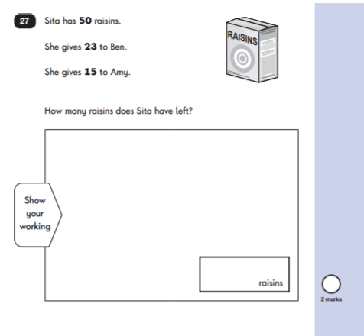
Solving Word Problems

Slide 23


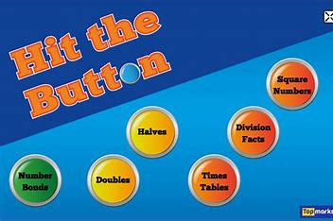
Ways to support your KS1 child
Hand actions for skipping counting and times tables
Counting up and down the stairs
Singing songs
Playing number related games

Slide 24
Maths
Year 3 & 4

Slide 25
Fluency Coverage
Number bonds to 10, 100 and making connections between them and how they apply to larger numbers.
Year 3 - Add and subtract three-digit number by ones, tens and hundreds
Year 4 are expected to go up to thousands.
Divide 100 into 2,4,5 and 10 equal parts.
Counting in steps of 50, 100, 200 and 250.
Negative numbers (counting).
By the end of Year 4 multiplication and division facts for multiplication tables up to 12 x 12
We also recap the formal methods of the four operations.

Slide 26
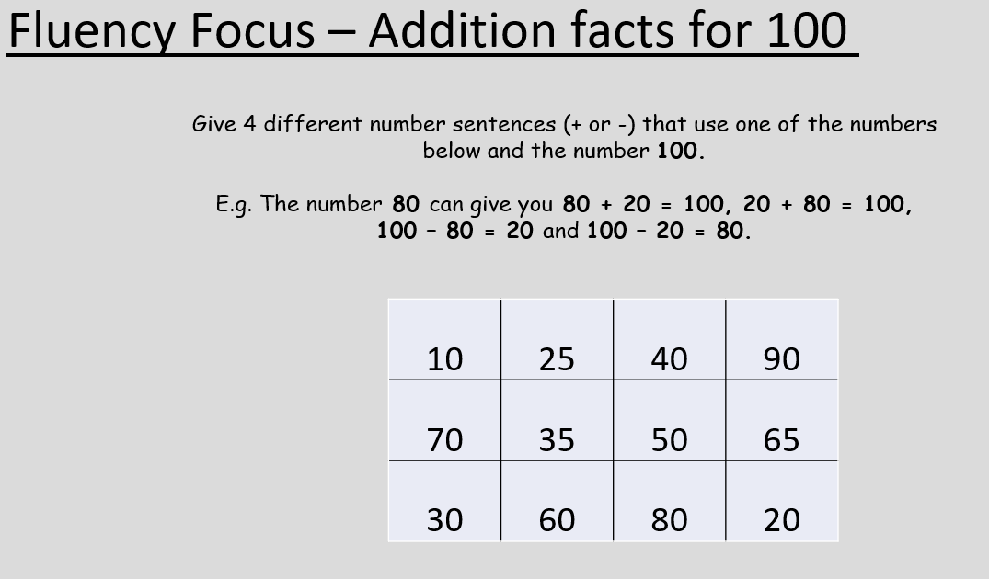
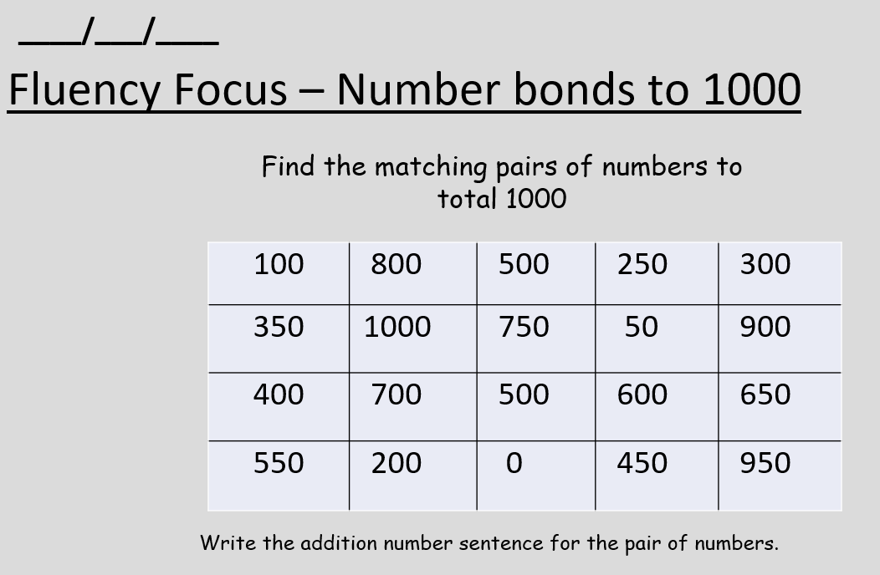
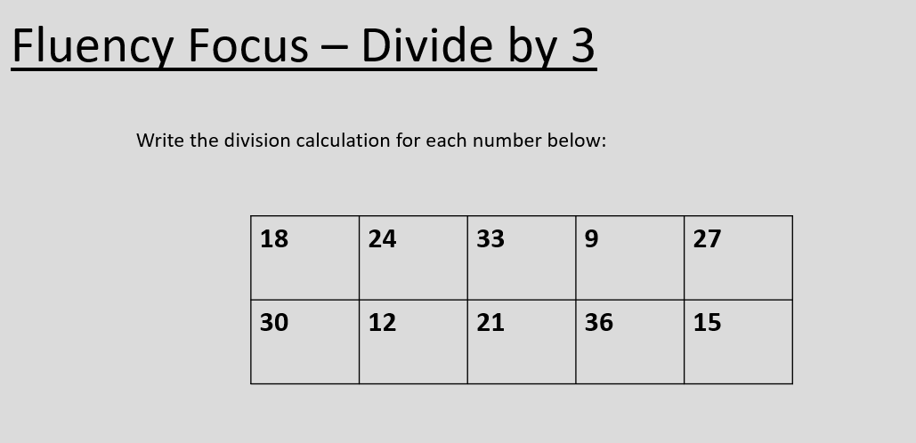
Year 3

Slide 27
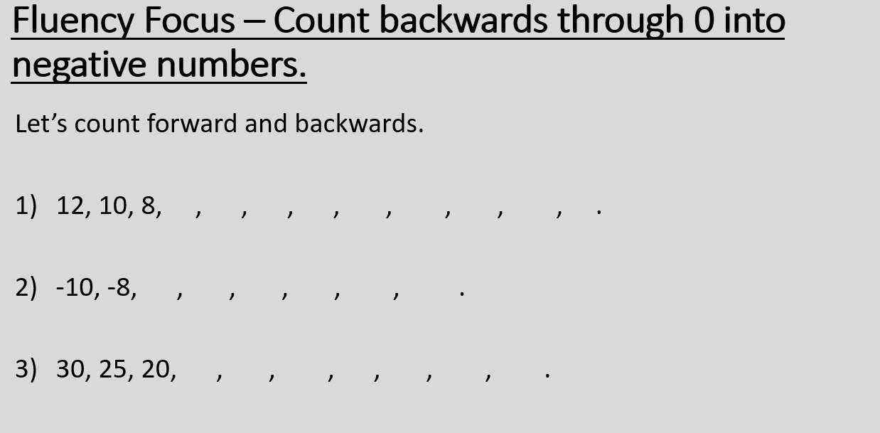
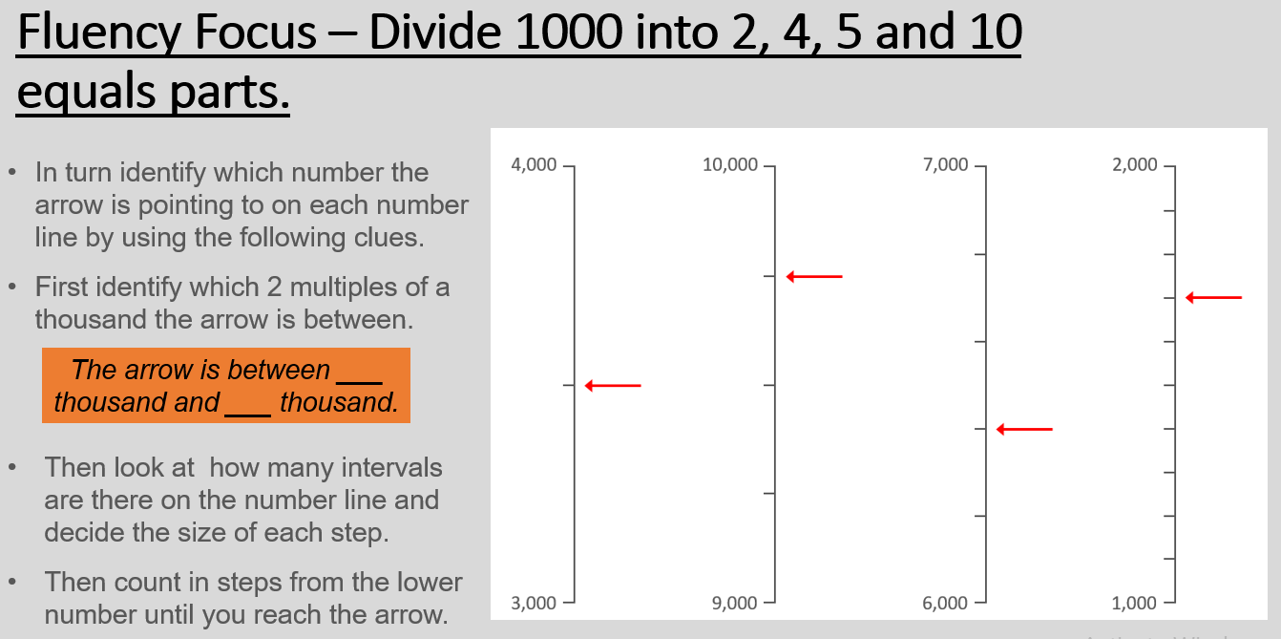
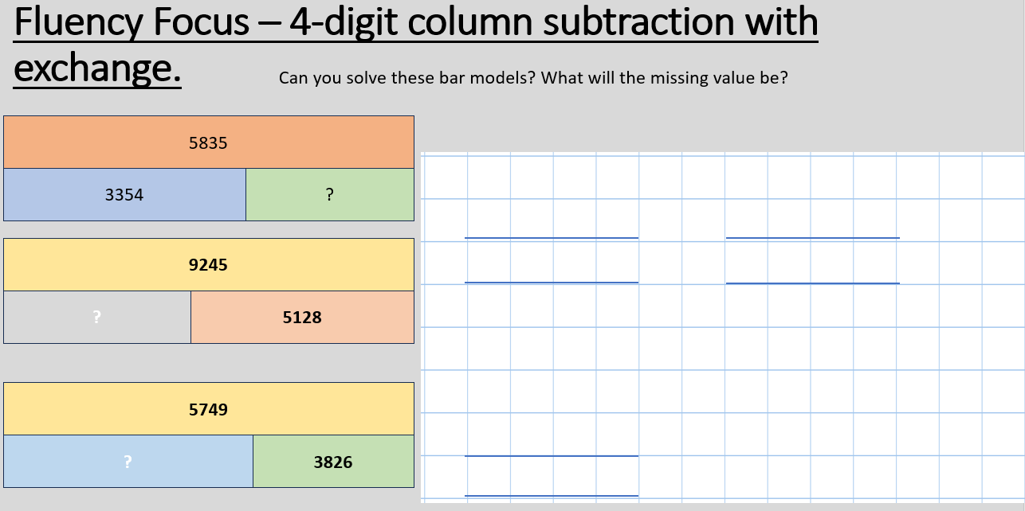
Year 4

Slide 28
MULTIPLICATION
KEY STAGE 2
Year 3 pupils should be taught to:
recall and use multiplication and division facts for the 3, 4 and 8 multiplication tables
Year 4 pupils should be taught to:
recall multiplication and division facts for multiplication tables up to 12 × 12
It is very difficult to access the Y5 and Y6 curriculum without knowing their tables facts
Notes:
Year 3:
Pupils develop efficient mental methods, for example, using commutativity and associativity (for example, 4 × 12 × 5 = 4 × 5 × 12 = 20 × 12 = 240) and multiplication and division facts (for example, using 3 × 2 = 6, 6 ÷ 3 = 2 and 2 = 6 ÷ 3) to derive related facts (for example, 30 × 2 = 60, 60 ÷ 3 = 20 and 20 = 60 ÷ 3).
Chn need to be able to fluently use multiplication facts to write and calculate mathematical statements for multiplication and division for 2 digit numbers x a 1 digit number.
Year 4:
Use multiplication facts with 2 and 3 digit numbers multiplied by a 1 digit number.
Pupils practise mental methods and extend this to three-digit numbers to derive facts, (for example 600 ÷ 3 = 200 can be derived from 2 x 3 = 6).

Slide 29
Times Tables
Year Group | Expectation
Year 1 | Count in multiples of 2, 5 and 10. Recall and use doubles to 10 and corresponding halves.
Year 2 | Recall and use multiplication and division facts for the 2, 5 and 10 multiplication tables, including recognising odd and even numbers
Year 3 | Recall and use multiplication and division facts for the 3, 4 and 8 multiplication tables
Year 4 | Recall multiplication and division facts for multiplication tables up to 12 x 12
Year 5 and 6 | Children are expected to already be fluent in their multiplication and division facts
Notes:
The expectation is that by the time your children have left Year 4 they will know all their multiplication and division facts, at speed.
They should only revisited in Year 5 and 6 through special numbers (factors, multiples, prime, cube and square).

Slide 30
Do you have a child in year 4 at primary school?
If so, your child will be participating in the multiplication tables check (MTC) in June.
The purpose of the check is to determine whether your child can fluently recall their times tables up to 12, which is essential for future success in mathematics.
It will also help your child’s school to identify if your child may need additional support

Slide 31
What is the multiplication tables check?
It is an on-screen check consisting of 25 times table questions.
Your child will be able to answer 3 practice questions before taking the actual check.
They will then have 6 seconds to answer each question.
On average, the check should take no longer than 5 minutes to complete

Slide 32
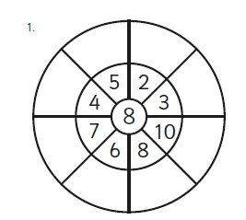

What do we do in school to help practise times tables?
Times tables practise is part of our daily fluency.
- Chanting our times tables (silly voices, missing numbers out, taking it in turns).
- Using class counting stick, especially when learning a new times table.
- Games/Competitions within class.
- Multiplication/division circles.
- Flashing Tables
- TT Rockstars.

Slide 33
Flashing Tables
Are you ready?

Slide 34
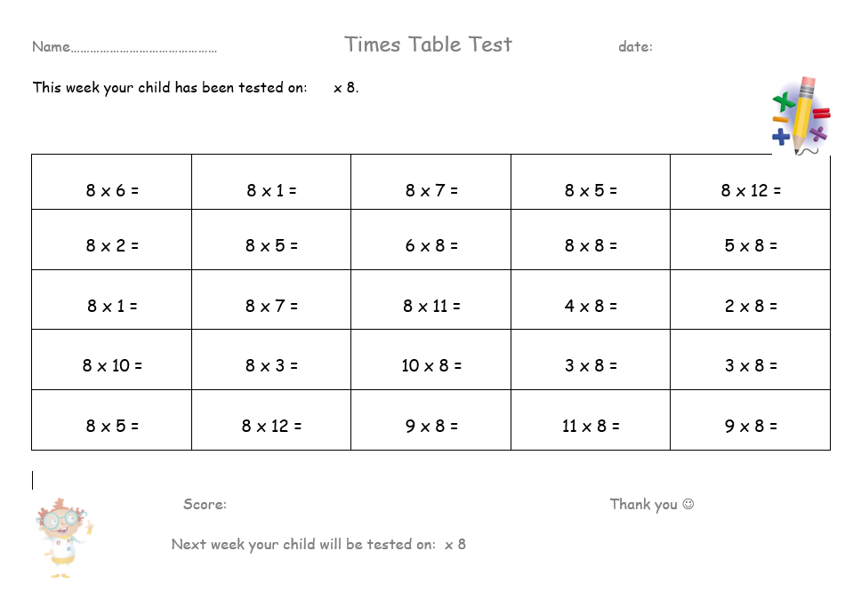

Slide 35
What can you do to support your child at home?
Times Tables:
- Songs from YouTube – Rolling Numbers.
- Play on TT rockstars each week!
- Reciting up and down the stairs (multiplication on the way up, division facts on the way down).
- Make your own flash cards with the answer on the back.
- Recite them together, taking turns
- Pop quiz while making breakfast, driving, walking to school, etc.
- Maths board games
- Get siblings to quiz them (fastest person to write them down).
- Roll dice to create multiplications.
- Fizz Buzz

Slide 36
Fizz Buzz – level 1
Fizz Buzz using the 5 times tables
1, 2, 3, 4, Buzz, 6, 7, 8, 9, Buzz, 11, 12, 13, 14, Buzz
Notes:
So how can you help your children learn their tables?
The children can play the games on MyMaths – which we will look at a bit later
There are a range of apps and websites that help you children with their multiplications. (there is a hand out at the back of the hall)
The children can count up and back in different multiples or chant their tables (little and often is best)
Play different games like Fizz Buzz.
Pick a multiplication table to practise. For this game the 5’s. The games starts by someone saying the number one and the person next to them saying two and so one. Each time you reach a multiple of 5, the child has to say Buzz.
Your turn.

Slide 37
Fizz Buzz – level 2
Multiple of 3 = Buzz
Multiple of 5 = Fizz
1, 2, Buzz, 4, Fizz, Buzz, 7, 8, Buzz, Fizz, 11, Buzz, 13, 14, FizzBuzz, 16, 17, Buzz, 19, Fizz
Play Fizz Buzz using multiples of 2 and 4
Buzz = x2
Fizz = x4
Notes:
The game can get a lot harder.
This time if the number is a multiple of 3 say Buzz but if it is a multiple of 5 say Fizz. When you get to 15 you would say Fizz Buzz because 15 is a multiple of both 3 and 5.
Your turn to try it out with 2x and 4x.
After the game you should have discovered that when you use the 2’s and 4’s you never say a Fizz without a Buzz because all of the multiples of 4 are also multiples of 2.

Slide 38
Year 5 and 6
Expectations:
To know all of the times table facts and making connections. Eg 6 x 7, 60 x 70, 5 minutes a day to embed it.
Questions where times tables knowledge is essential.
Square and cube numbers.
To know times tables so they are efficient in written methods
Multiplying and dividing by 10 and 100, 1000.
Number bonds to 10, 100, 1000 and making connections between them and how they apply to larger numbers.
Real world discussions and when maths is used in everyday life.

Slide 39
Times Tables
Year Group | Expectation
Year 1 | Count in multiples of 2, 5 and 10. Recall and use doubles to 10 and corresponding halves.
Year 2 | Recall and use multiplication and division facts for the 2, 5 and 10 multiplication tables, including recognising odd and even numbers
Year 3 | Recall and use multiplication and division facts for the 3, 4 and 8 multiplication tables
Year 4 | Recall multiplication and division facts for multiplication tables up to 12 x 12
Year 5 and 6 | Children are expected to already be fluent in their multiplication and division facts
Notes:
The expectation is that by the time your children have left Year 4 they will know all their multiplication and division facts, at speed.
They should only revisited in Year 5 and 6 through special numbers (factors, multiples, prime, cube and square).
The government is planning a national voluntary roll out of a multiplication tables test from June 2019, before it becomes mandatory in June 2020. The test will be taken by all children in Year 4.

Slide 40
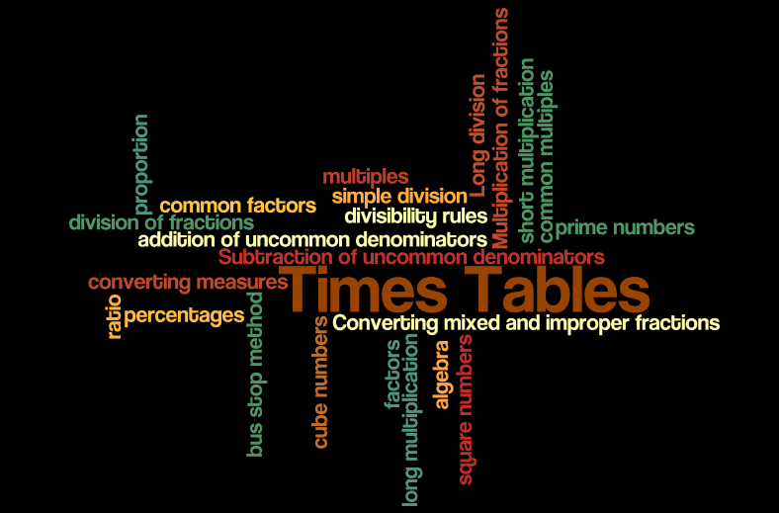
Times Tables
Notes:
Times tables are one of the most important areas of maths.
If you don’t know your times tables you can not access…
Times Tables, simple division, bus stop division method, Long division, addition and subtraction of fractions with different denominators, Converting mixed and improper fractions, Multiplication and division of fractions, ratio, proportion, algebra, prime numbers, square numbers, multiples, factors, cubed numbers, percentages, long multiplication, short multiplication, converting measures, common multiples, common factors and divisibility rules.
They are interwoven into many areas of Mathematics:

Slide 41


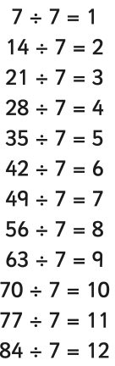
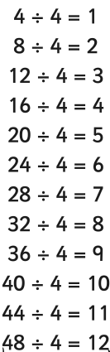
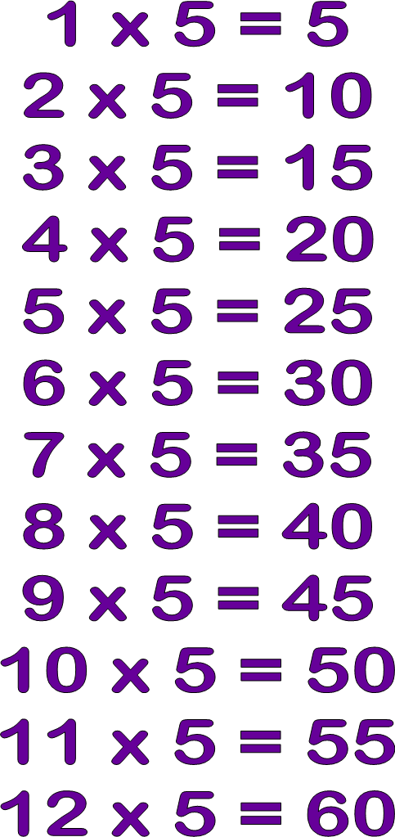
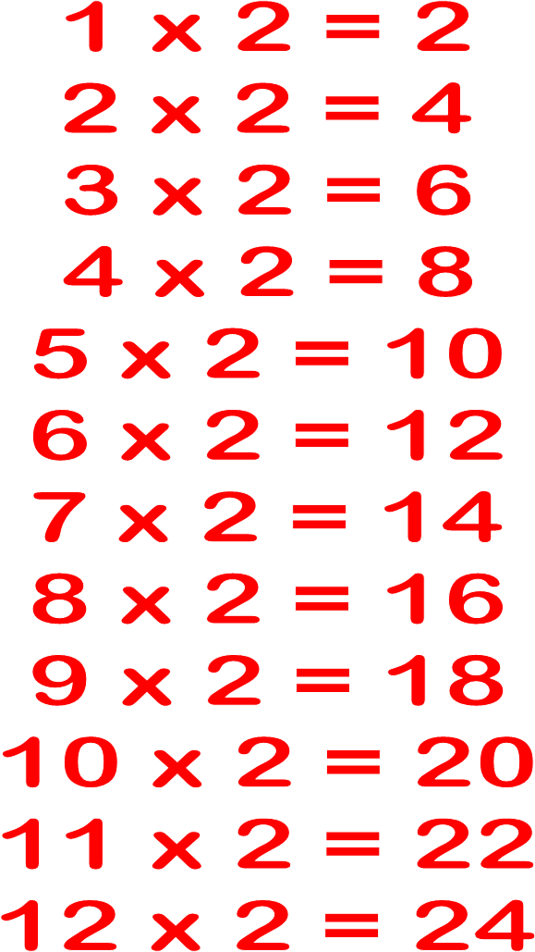
Times tables
Notes:
And division facts

Slide 42
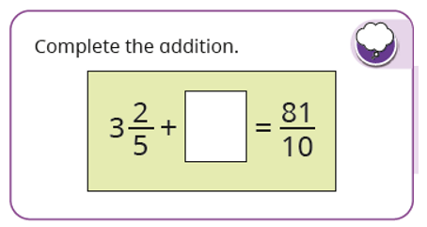
How do our times tables link to fractions?

Slide 43
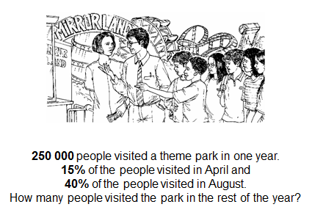
How would you approach this?
Notes:
Here is a typical Year 6 SATs question.
What maths do you think you need to be able to solve this problem? Parents offer up ideas… maybe!
Place value – recognise each digit, know what 250000 means
Read and understand the word ‘one’
Understand % sign
Add together 15 and 40
Work out how to find a percentage
Multiplication and division facts
Estimation skills (checking answer)
Subtract 137500 from 250 000.
Have a go.
How would you do it?
We would expect most of the children to do this mentally.
LT TO MODEL ON WHITEBOARD
We know that 10% of 250000 is 25000
So, 5% is half of this (12500)
So, 15% is 25000 add 12500 which is 37500
If 10% is 25000, then 40% is 4 times as much, which is 100000 (one hundred thousand)
We know that 55% of people visited in April and August, so 45% visited the rest of the time.
45% is 40% add 5%... So 100000 add 12500 therefore 112500

Slide 44


Slide 45
To know all the times table facts and making connections. E.g. 6 x 7,
60 x 70. 5 minutes a day to embed it.
If I know…
4 x 6 = 24
I also know

Slide 46
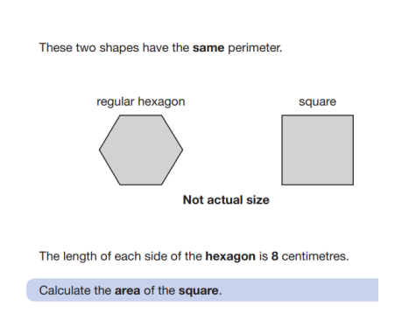
Questions where times tables knowledge is essential.

Slide 47
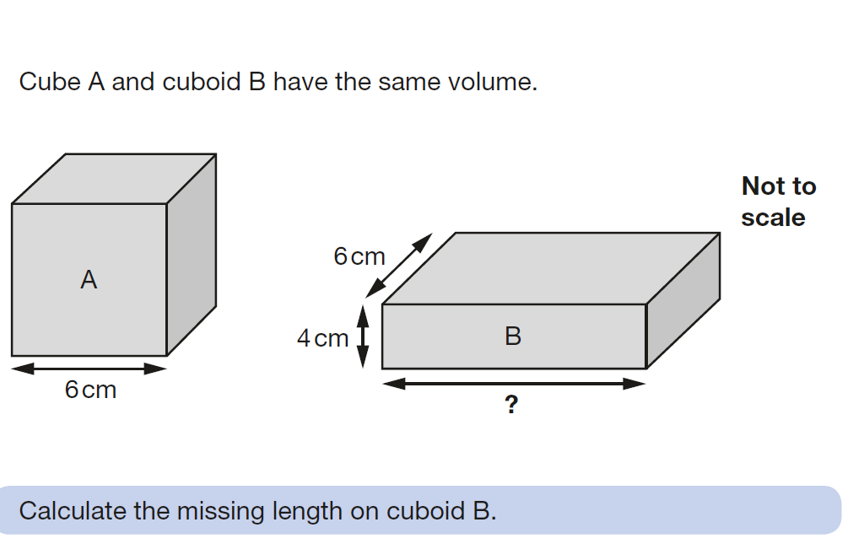
Questions where times tables knowledge is essential.

Slide 48
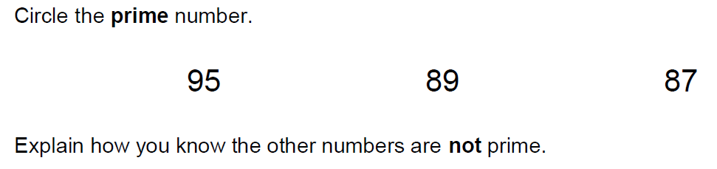
Questions where times tables knowledge is essential.

Slide 49
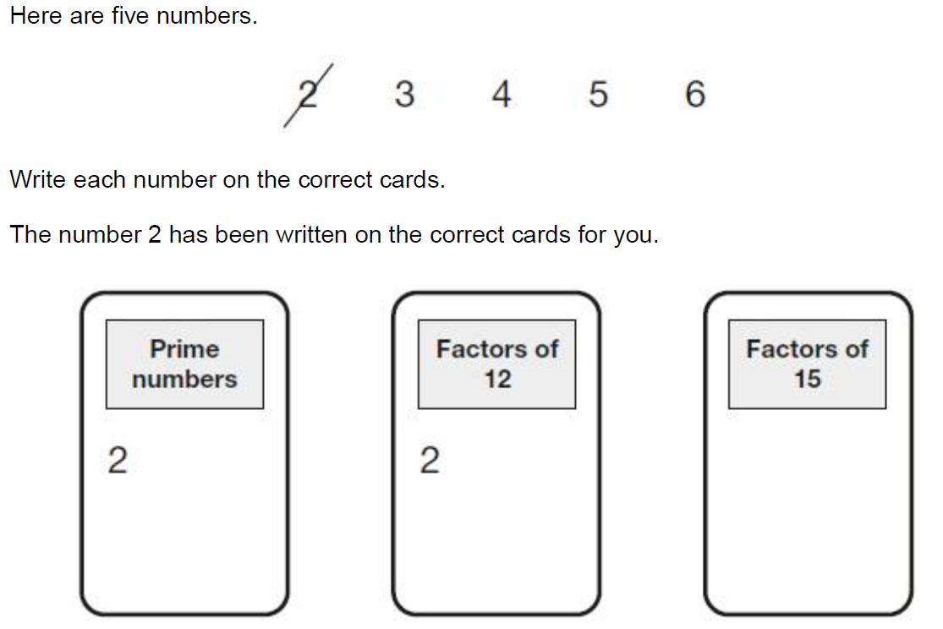
Questions where times tables knowledge is essential.

Slide 50
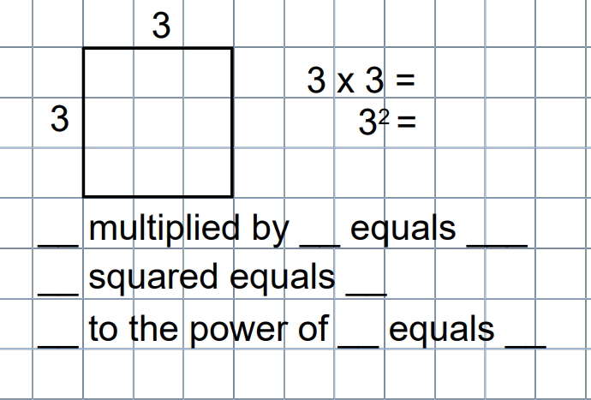
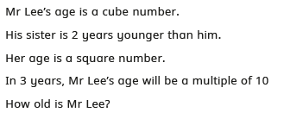
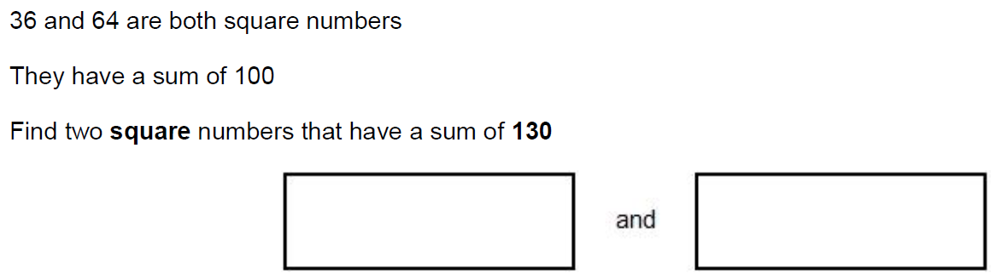
Square and cube numbers.

Slide 51
Why do we need to know the times tables in the year 5 and 6 curriculum? Efficient methods.
99% of 280
Find 90%
Find 5%
Find 1% x 4
Add
Find 1%
Subtract from 280

Slide 52
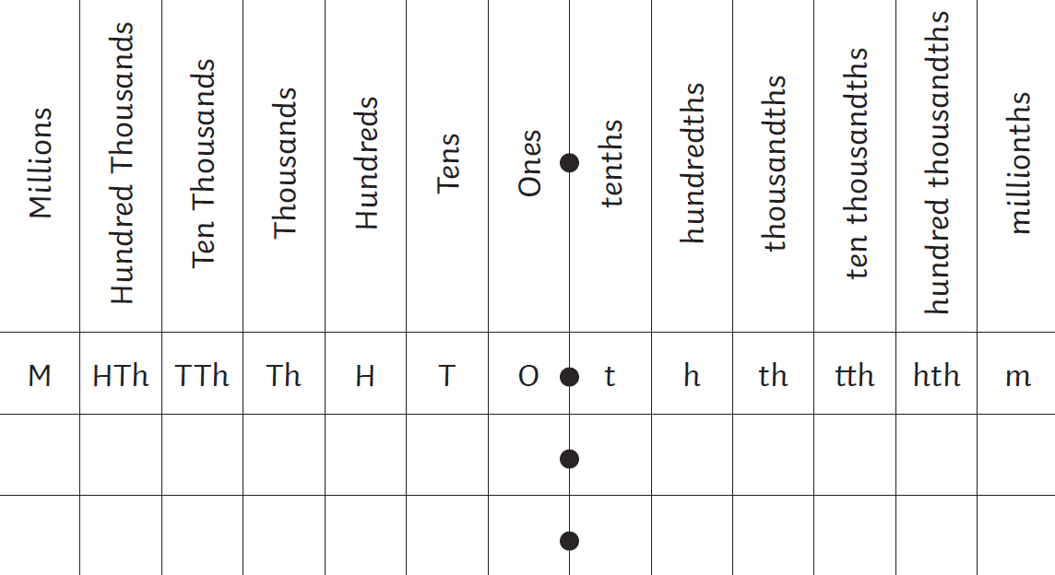
Multiplying and dividing by 10 and 100, 1000.

Slide 53
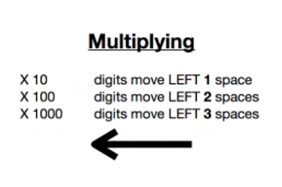
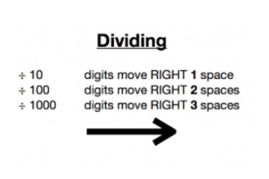
Multiplying and dividing by 10 and 100, 1000.

Slide 54
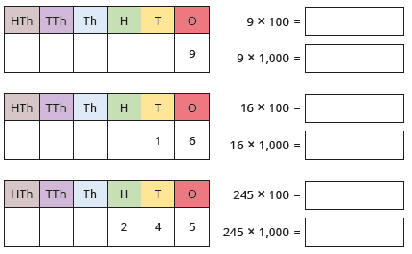
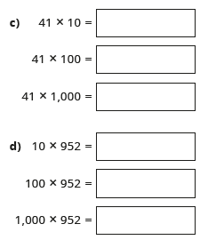
Linked knowledge across multiplying and dividing by 10, 100 and 1,000.
How would you work out the following?

Slide 55
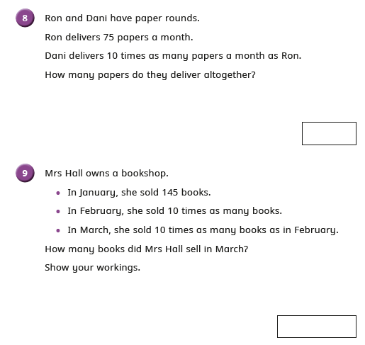
It also links to word problems too!

Slide 56
Number bonds to 10, 100, 1000 and making connections between them and how they apply to larger numbers.
4+6= 10 so 40 + 60=100 and 400+600=1000
10-6=4 so 100-60=40 and 1000-600=400
43 + 57=100 and 430+570=1000
100-43=57 and 1000-430=570

Slide 57

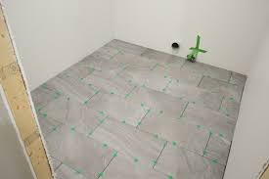
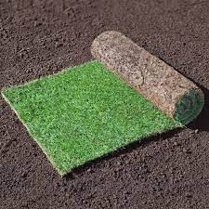

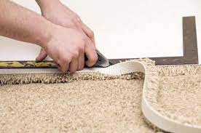
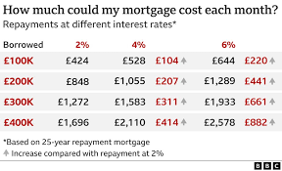
Real world discussions and when maths is used in everyday life.

Slide 58
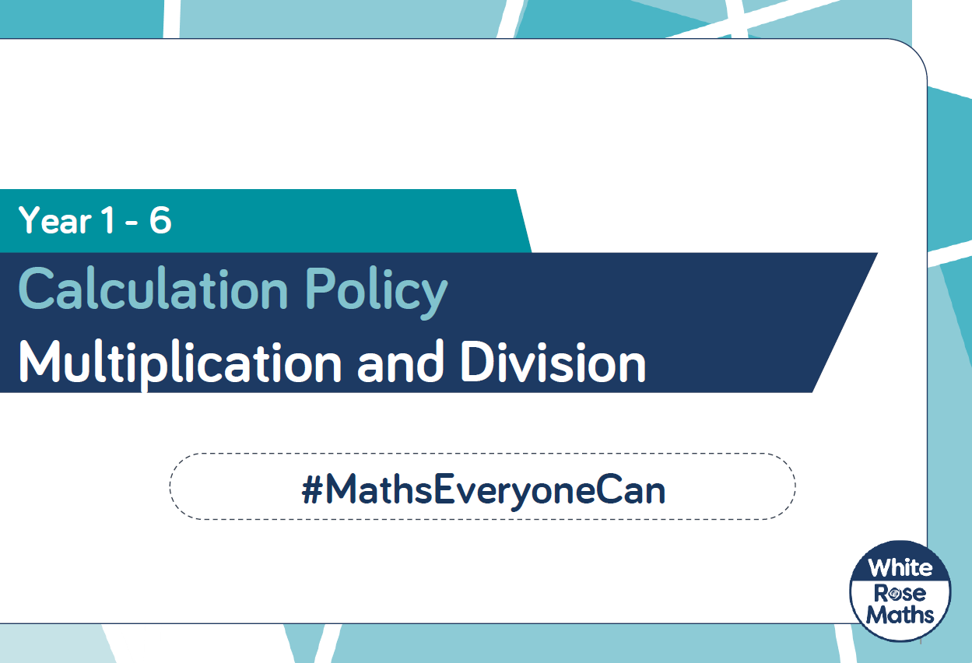
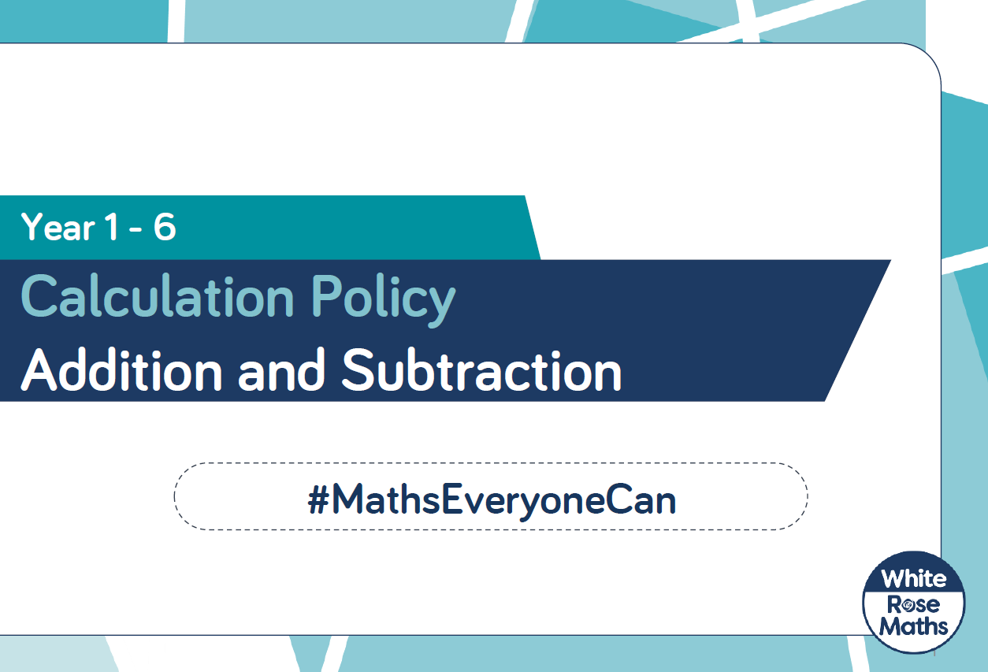
https://www.lacewood.org.uk/white-rose-maths-calculation-policies/

